Slide 1
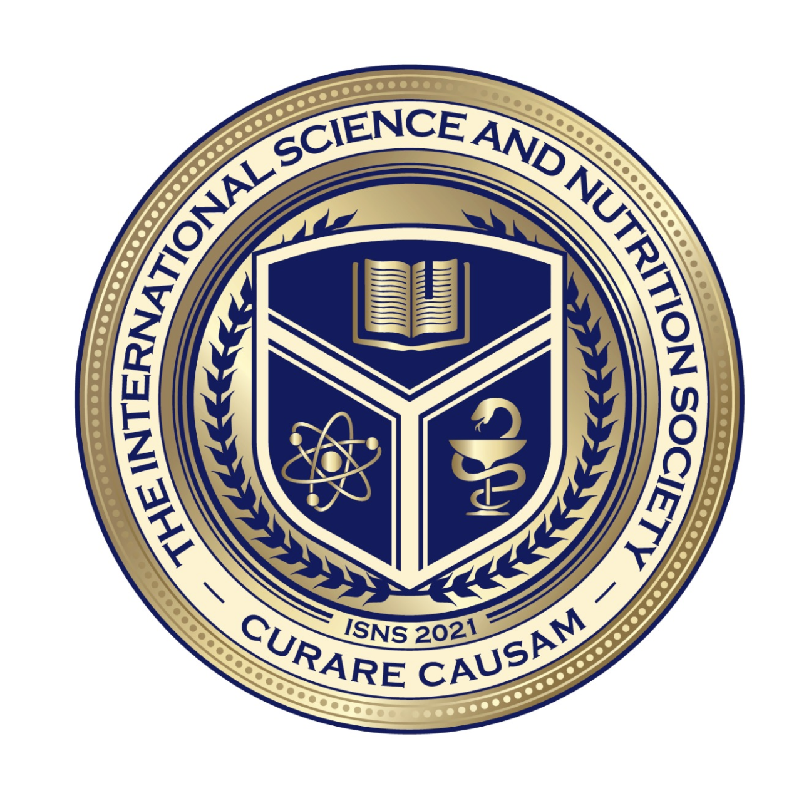
We will get started shortly.
International Science Nutrition Society – CURARE CAUSAM - ISNS 2023

Slide 2
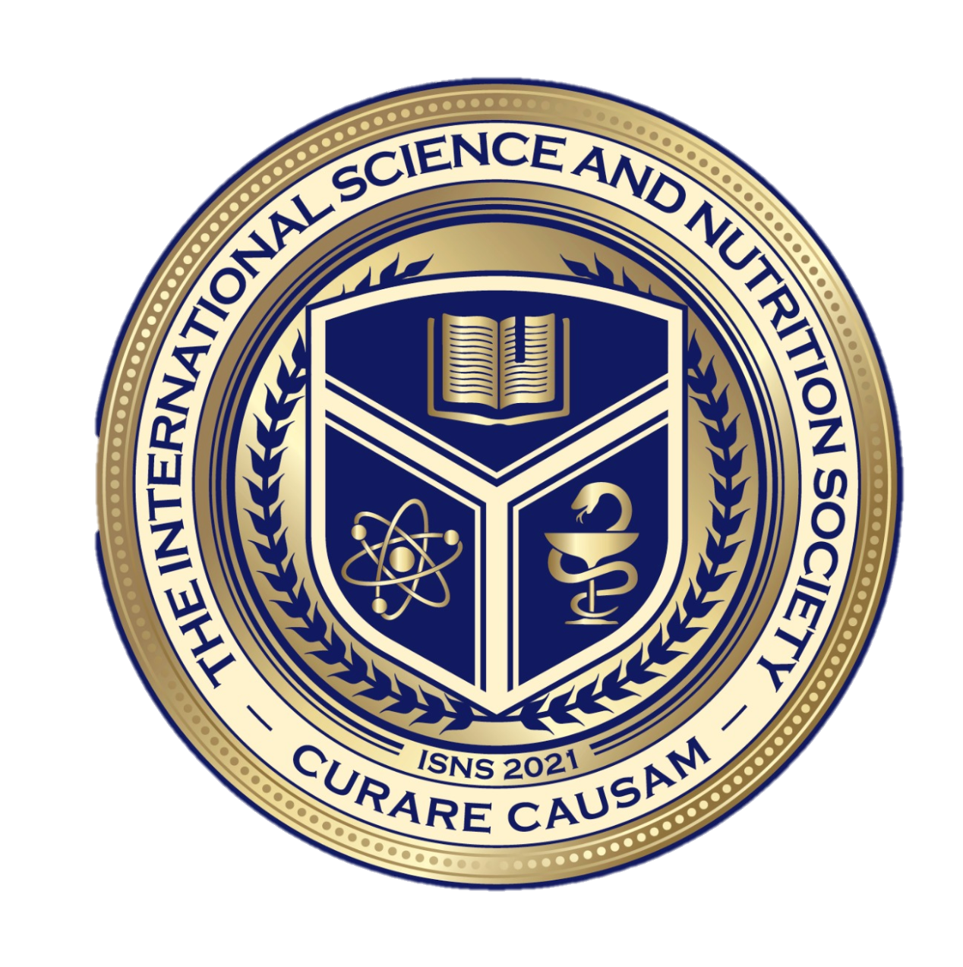
ISNS CASE STUDY
With Dr. Norbert Ketskes on High Blood Pressure (Hypertension)
International Science Nutrition Society – CURARE CAUSAM - ISNS 2023

Slide 3
Medical Disclaimer
The information provided is for educational purposes and is not intended as medical advice, or a substitute for the medical advice of a physician or other qualified health care professional. This is for science and educational purposes only and cannot be used in any aspect for sales or marketing. You should not use this information for diagnosing a health or fitness problem or disease. You should always consult with a doctor or other health care professional for medical advice or information about diagnosis and treatment. This is Confidential. Do not distribute—for scientific educational purposes only.
International Science Nutrition Society – CURARE CAUSAM - ISNS 2023

Slide 5
DR. NORBERT KETSKÉS, MD
Dr. Norbert Ketskés M.D. is one the most acknowledged gastroenterologist in Hungary, specializing in natural and organic nutritional solutions, leading the well-known Primus Labor, a private clinic offering personalized nutritional advices to its patients.
Scientific Adviser of ISNS
Independent Scientific Adviser of Rain International in Europe since 2013
Medical Partner of the Hungarian Olympic Committee since 2015
Member of the Medical board of Hungarian Karate Association since 2015
Leader of the Primus Labor Private Medical Clinic since 2013
Working as a Family Doctor 1999 – 2012
International Science Nutrition Society – CURARE CAUSAM - ISNS 2023

Slide 6
CSISZTU ZSUZSA
Television - Presenter, Anchor, Editor, Journalist and Sports Lawyer, Sport-diplomat
Spokesperson of the Giro d’Italia Grande Partenza, (Road-Cycling World -Tour Championship)
Spokesperson of the FINA (Swimming and Waters poets World Championship)
2022 Vice-President of the Hungarian Sports Journalists’ Association
Member of the Hungarian Olympic Committee Member of the Advisory Board of the Hungarian Olympic Academy
Newly Elected Vice-President of the International Sports Journalists Association, the first female ever in the field from her homeland, and third globally since 1924 (AIPS)
International Science Nutrition Society – CURARE CAUSAM - ISNS 2023

Slide 7
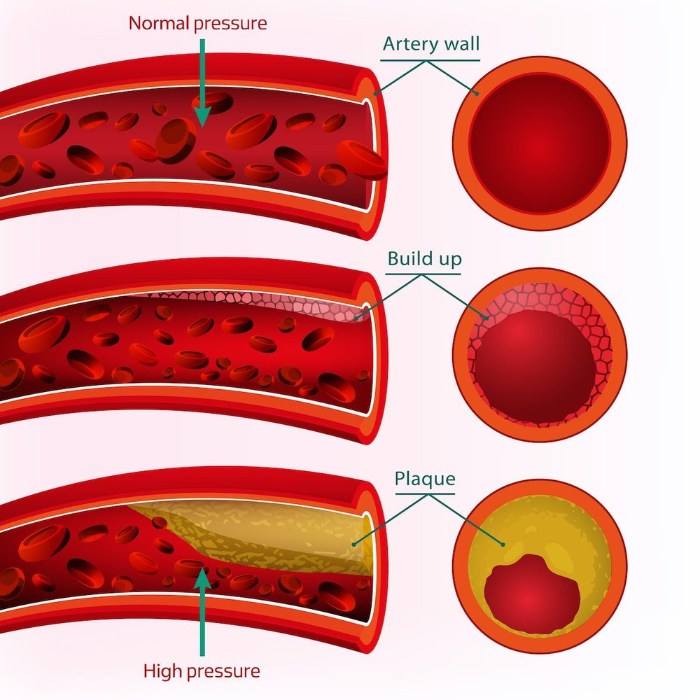
What is Hypertension?
High blood pressure is a common condition that affects the body’s arteries. It’s also called hypertension. If you have high blood pressure, the force of blood pushing against the artery walls is consistently too high. The heart must work harder to pump blood. Blood pressure is measured in millimeters of mercury (mm Hg). In general, hypertension is a blood pressure reading of 130/80 mm Hg or higher.
International Science Nutrition Society – CURARE CAUSAM - ISNS 2023

Slide 8
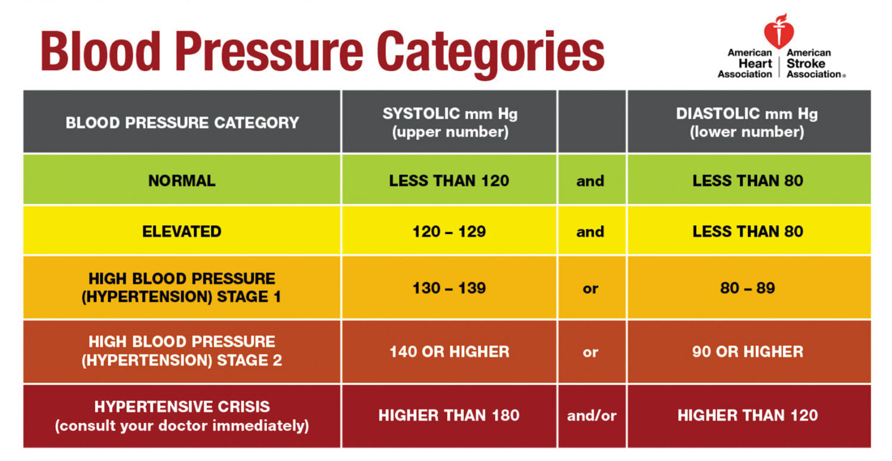
The 4 General Types of Blood Pressures
The American College of Cardiology and the American Heart Association divides blood pressure into four general categories. Ideal blood pressure is categorized as normal.
Normal Blood Pressure – Blood pressure is 120/80 mm Hg or lower
Elevated Blood Pressure- The top number ranges from 120 to 129 mm Hg, and the bottom number is below, not above 80 mm Hg
Stage 1 Hypertension- The top number ranges from 130 to 139 mm Hg, or the bottom number is between 80 to 89 mm Hg
Stage 2 Hypertension- The top number is 140 mm Hg or higher, or the bottom number is 90 mm Hg or higher
International Science Nutrition Society – CURARE CAUSAM - ISNS 2023

Slide 9
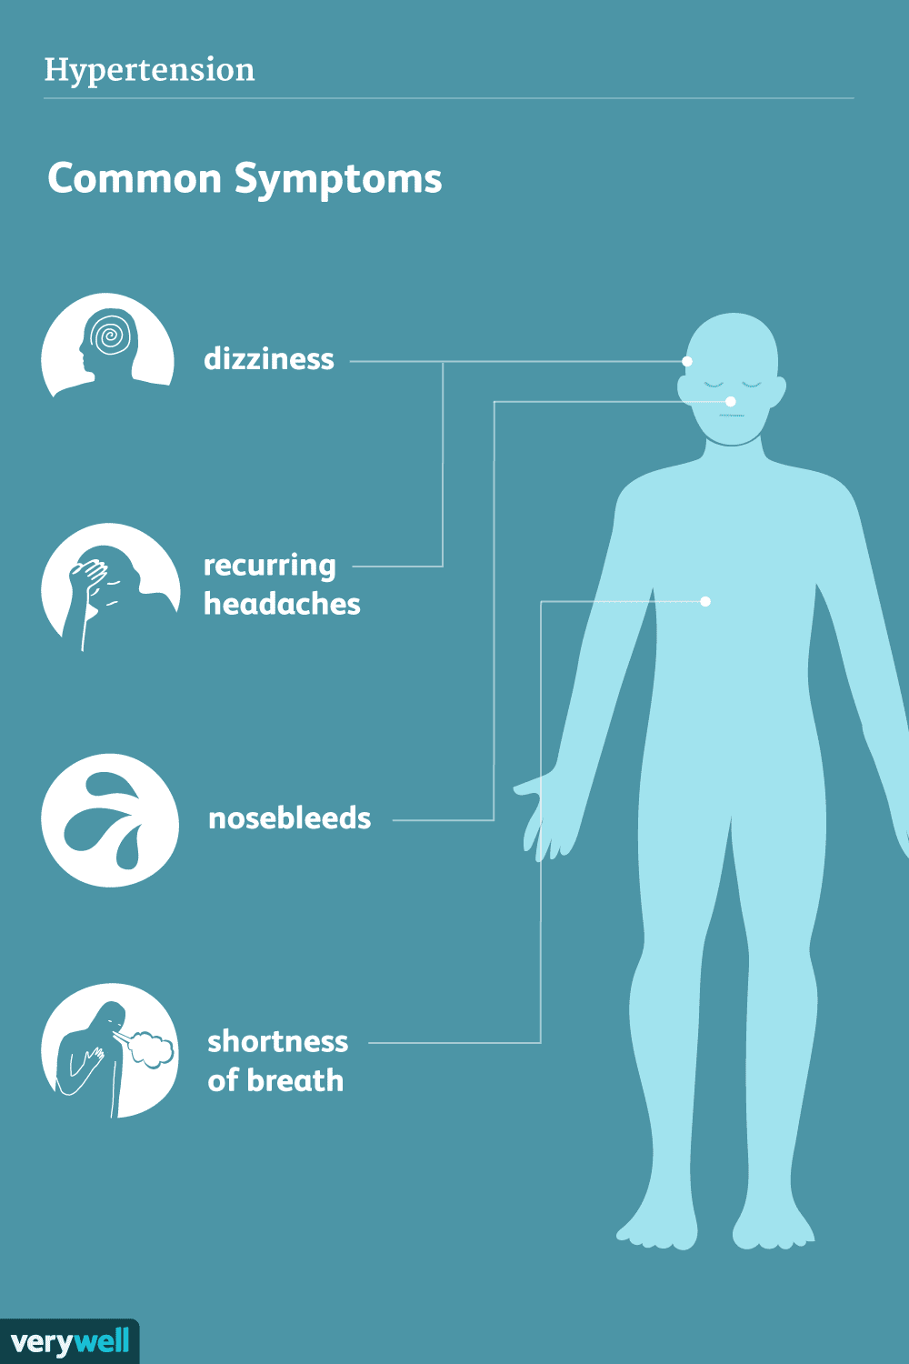
What are the symptoms of Hypertension?
Most people with high blood pressure have no symptoms, even if blood pressure readings reach dangerously high levels. You can have high blood pressure for years without any symptoms.
Individuals with high blood pressure may have:
Headaches
Shortness of Breath
Nosebleeds
These symptoms are not specific. They usually do not occur until high blood pressure has reached a severe or life-threatening stage.
International Science Nutrition Society – CURARE CAUSAM - ISNS 2023

Slide 10
Causes of Hypertension
Blood pressure is determined by two things: the amount of blood the heart pumps and how hard it is for the blood to move through the arteries. The more blood the heart pumps and the narrower the arteries, the higher the blood pressure.
There are two types of high blood pressure:
Primary hypertension, also called essential hypertension
For most adults, there’s no identifiable cause of high blood pressure. This type of high blood pressure is called primary hypertension or essential hypertension. It tends to develop gradually over many years. Plaque buildup in the arteries, called atherosclerosis, increases the risk of high blood pressure.
Secondary hypertension
This type of high blood pressure is caused by an underlying condition. It tends to appear suddenly and cause high blood pressure than does primary hypertension. Conditions and medications that can lead to secondary hypertension include:
Adrenal gland tumors
Blood vessel problems present at birth, also called congenital heart defects
Cough and cold medicines, some pain relievers, birth control pills, and other prescription drugs
Illegal drugs, such as cocaine and amphetamines
Kidney disease
Obstructive sleep apnea
Thyroid problems
Sometimes just getting a health checkup causes blood pressure to increase. This is called white-coat hypertension
International Science Nutrition Society – CURARE CAUSAM - ISNS 2023

Slide 11
Risk Factors for Hypertension
High blood pressure has many risk factors, including:
Age– the risk of high blood pressure increases with age.
Race- high blood pressure is particularly common among African Americans
Family history- You’re more likely to develop high blood pressure if you have a parent or sibling with the condition
Obesity or being overweight- Excess weight causes changes in the blood vessels, the kidneys and other body parts. These changes often increase blood pressure. Being overweight or having obesity also raises the risk of heart disease and its risk factors, such as high cholesterol.
Lack of exercise- Not exercising can cause weight gain. Increased weight raises the risk of high blood pressure. People who are inactive also tend to have higher heart rates
Too much salt- a lot of salt- also called sodium, in the body can cause the body to retain fluid. This increases blood pressure
Tobacco use or vaping- smoking, chewing tobacco or vaping immediately raises blood pressure for a short while. Tobacco smoking injures blood vessel walls and speeds up the process of hardening of the arteries.
Low potassium levels- Potassium helps balance the amount of salt in the body’s cells. A proper balance of potassium is important for good heart health.
Drinking too much alcohol- Alcohol use has been linked with increased blood pressure, particularly in men
Stress- high-stress levels can lead to a temporary increase in blood pressure. Stress-related habits such as eating more, using tobacco, or drinking alcohol can lead to further increases in blood pressure
Certain chronic conditions- Kidney disease, diabetes, and sleep apnea are some of the conditions that can lead to high blood pressure
Pregnancy- Sometimes pregnancy can cause high blood pressure
International Science Nutrition Society – CURARE CAUSAM - ISNS 2023

Slide 12
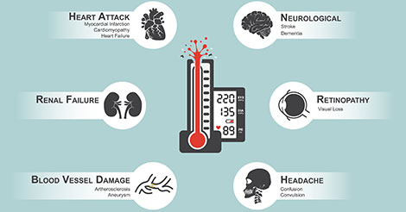
Complications caused by Hypertension
The excessive pressure on the artery walls caused by high blood pressure can damage blood vessels and body organs. The higher the blood pressure and the longer it goes uncontrolled, the greater the damage.
Uncontrolled high blood pressure can lead to complications, including:
Heart attack or stroke- hardening and thickening of the arteries due to high blood pressure or other factors can lead to heart attack, stroke, or other complications
Aneurysm- Increased blood pressure can cause a blood vessel to weaken and bulge, forming an aneurysm. If an aneurysm ruptures, it can be life-threatening.
International Science Nutrition Society – CURARE CAUSAM - ISNS 2023

Slide 13
Complications caused by Hypertension
Heart failure- Having high blood pressure causes the heart to work harder to pump blood. The strain causes the walls of the heart’s pumping chamber to thicken. This condition is called left ventricular hypertrophy. Eventually, the heart cannot pump enough blood to meet the body’s needs, causing heart failure.
Kidney problems- High blood pressure can cause the blood vessels in the kidneys to become narrow or weak. This can lead to kidney damage.
Eye problems- increased blood pressure can cause thickened, narrow, or torn blood vessels in the eyes. This can result in vision loss.
Metabolic syndrome- This syndrome is a group of disorders of the body’s metabolism. It involves the irregular breakdown of sugar, also called glucose. The syndrome includes increased waist size, high triglycerides, decreased high-density lipoprotein (HDL “good”) cholesterol, high blood pressure, and high blood sugar levels. These conditions make you more likely to develop diabetes, heart disease, and stroke.
Changes with memory or understanding- Uncontrolled blood pressure may affect the ability to think, remember and learn.
Dementia- Narrowed or blocked arteries can limit blood flow to the brain. This can cause a certain type of dementia called vascular dementia. A stroke that interrupts blood flow to the brain can also cause vascular dementia.
International Science Nutrition Society – CURARE CAUSAM - ISNS 2023

Slide 14
CASE STUDY
Patient:
Age:
History:
Medical history:
Clinical tests:
International Science Nutrition Society – CURARE CAUSAM - ISNS 2023

Slide 15
Conventional Treatment
Simple lifestyle changes can help reduce high blood pressure, although some people may need to take medicine as well. Your general physician can advise you about changes you can make to your lifestyle and discuss whether they think you would benefit from medicine.
Everyone with high blood pressure is advised to make healthy lifestyle changes.
Whether medicine is also recommended depends on your blood pressure reading and your risk of developing problems such as heart disease and strokes.
Several types of medicines can be used to help control high blood pressure. Many people take a combination of different medicines.
If you’re under 55- you’ll usually be offered an ACE inhibitor or angiotensin-2 receptor blocker (ARB)
If you are over 55 or you are any age and of African or Caribbean origin- you’ll usually be offered a calcium channel blocker
International Science Nutrition Society – CURARE CAUSAM - ISNS 2023

Slide 16
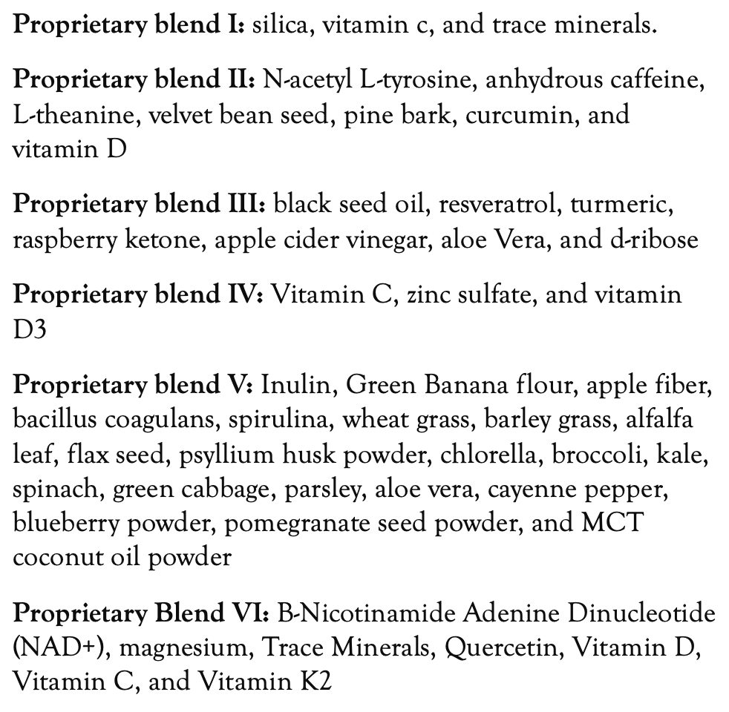
Method
PROPRIETARY BLENDS LEGEND
Proprietary blend I:
Proprietary blend II
Proprietary blend III:
Proprietary blend IV:
Proprietary blend V:
Proprietary blend VI:
International Science Nutrition Society – CURARE CAUSAM - ISNS 2023

Slide 17
Additional Treatment
International Science Nutrition Society – CURARE CAUSAM - ISNS 2023

Slide 18
Results
International Science Nutrition Society – CURARE CAUSAM - ISNS 2023

Slide 19
Research Studies
International Science Nutrition Society – CURARE CAUSAM - ISNS 2023

Slide 20
The effect of Curcumin/Turmeric on blood pressure modulation: A systematic review and meta-analysis Amir Hadi, Makan Pourmasoumi, Ehsan Ghaedi, Amirohossein Sahebkar
A systematic search was undertaken in Medline, Embase, Scopus, ISI Web of Science, Google Scholar and Cochrane library up to May 2019 to identify randomized clinical trials assessing the effect of curcumin/turmeric on systolic BP (SBP) and diastolic BP (DBP). A random-effects model was used to analyze the impact of combined trials. Cochrane Risk of Bias Tool was applied to assess potential risks of bias.
A total of 11 studies comprising 734 participants were eligible and included in the meta-analysis to estimate pooled effect size. Results of the meta-analysis did not indicate any significant effect of curcumin/turmeric on SBP (-0.69 mmHg; 95% CI: -2.01, 0.64; I² = 18%) and DBP (0.28 mmHg; 95% CI: -1.12, 1.68; I² = 53%). However, subgroup analysis revealed a significant reduction only in SBP levels (-1.24 mmHg; 95% CI: -2.26, -0.22; I² = 0%) but not DBP (0.29 mmHg; 95% CI: -0.65, 1.22; I² = 1%) in studies with ≥12-week supplementation. No favorable effect of curcumin administration on SBP or DBP levels was found after stratification according to either participant's condition or type of intervention (turmeric, crude curcumin and high-absorption curcumin).
The present meta-analysis suggests that consuming curcumin/turmeric may improve SBP when administered in long durations. However, more studies are needed to confirm these results.
https://pubmed.ncbi.nlm.nih.gov/31647981/
International Science Nutrition Society – CURARE CAUSAM - ISNS 2023

Slide 21
Effects of vitamin C supplementation on Blood pressure: a meta-analysis of randomized controlled trials Stephen P Juraschek, Eliseo Gullar, Lawrence J Appel, and Edgar R Miller, III
The objective was to conduct a systematic review and meta-analysis of clinical trials that examined the effects of vitamin C supplementation on BP.
We searched Medline, EMBASE, and Central databases from 1966 to 2011. Prespecified inclusion criteria were as follows: 1) use of a randomized controlled trial design; 2) trial reported effects on systolic BP (SBP) or diastolic BP (DBP) or both; 3) trial used oral vitamin C and concurrent control groups; and 4) trial had a minimum duration of 2 wk. BP effects were pooled by random-effects models, with trials weighted by inverse variance.
In short-term trials, vitamin C supplementation reduced SBP and DBP. Long-term trials on the effects of vitamin C supplementation on BP and clinical events are needed.
https://www.ncbi.nlm.nih.gov/pmc/articles/PMC3325833/
International Science Nutrition Society – CURARE CAUSAM - ISNS 2023

Slide 22
The Role of Magnesium in Hypertension and Cardiovascular Disease Mark Houston, MD, MS
The combination of increased intake of magnesium and potassium coupled with reduced sodium intake is more effective in reducing BP than single mineral intake. It is often as effective as one antihypertensive drug in treating hypertension. Reducing intracellular sodium and calcium while increasing intracellular magnesium and potassium improves BP response. Magnesium also increases the effectiveness of all antihypertensive drug classes.
Magnesium lowers intracellular sodium and calcium, which enhances BP reduction. Magnesium is a natural calcium channel blocker, blocks sodium attachment to vascular smooth muscle cells, increases vasodilating PGE, binds potassium in a cooperative manner, increases nitric oxide, improves endothelial dysfunction, causes vasodilation, and reduces BP.
https://www.ncbi.nlm.nih.gov/pmc/articles/PMC8108907/
International Science Nutrition Society – CURARE CAUSAM - ISNS 2023

Slide 23
References
https://www.cdc.gov/bloodpressure/about.htm
https://pubmed.ncbi.nlm.nih.gov/31647981/
https://www.ncbi.nlm.nih.gov/pmc/articles/PMC3325833/
https://www.ncbi.nlm.nih.gov/pmc/articles/PMC8108907/
International Science Nutrition Society – CURARE CAUSAM - ISNS 2023

Slide 24
Thank You for Joining Us This Week!!
International Science Nutrition Society – CURARE CAUSAM - ISNS 2023

